Slide 1
Wicomico County Revenue Cap
Developed By: The Greater Salisbury Committee
Data Collection and Analysis Provided By: BEACON at Salisbury University

Slide 2
Overview
The Wicomico County revenue cap was amended to the County Charter in November, 2000. In the years leading up to the revenue cap, the County Council maintained a record of no increases in the property tax rate
While this long period of no property tax increases was very popular with the electorate, the county was deferring a number of needed expenditures including inflation and market adjustments for county employee compensation.
In order to maintain funding for education, maintenance of infrastructure, and other services taxpayers demand, the County Council implemented a record increase of 46 cents in the property tax
  This substantial increase in the property tax was a direct result of the lack of increases leading up to this point.
  After years of no tax increases a sudden 24% jump in the property tax rate resulted in a taxpayer revolt
  The revenue cap was voted into the County Charter on July 1st, 2001 and remains in effect today

Slide 3
Features of the Revenue Cap
Limits the County’s revenue from real property taxes to no more than 2% from the previous year or the CPI-U inflation rate (whichever is less)
The Property Tax Rate can still change from year to year (Revenue cap is NOT a property tax rate cap)
During economic downturns in the economy (when real estate values fall) the property tax rate can increase as long as the total new revenue stays within the cap’s limits
When the economy is growing (when real estate values increase) the rate can decrease

Slide 4
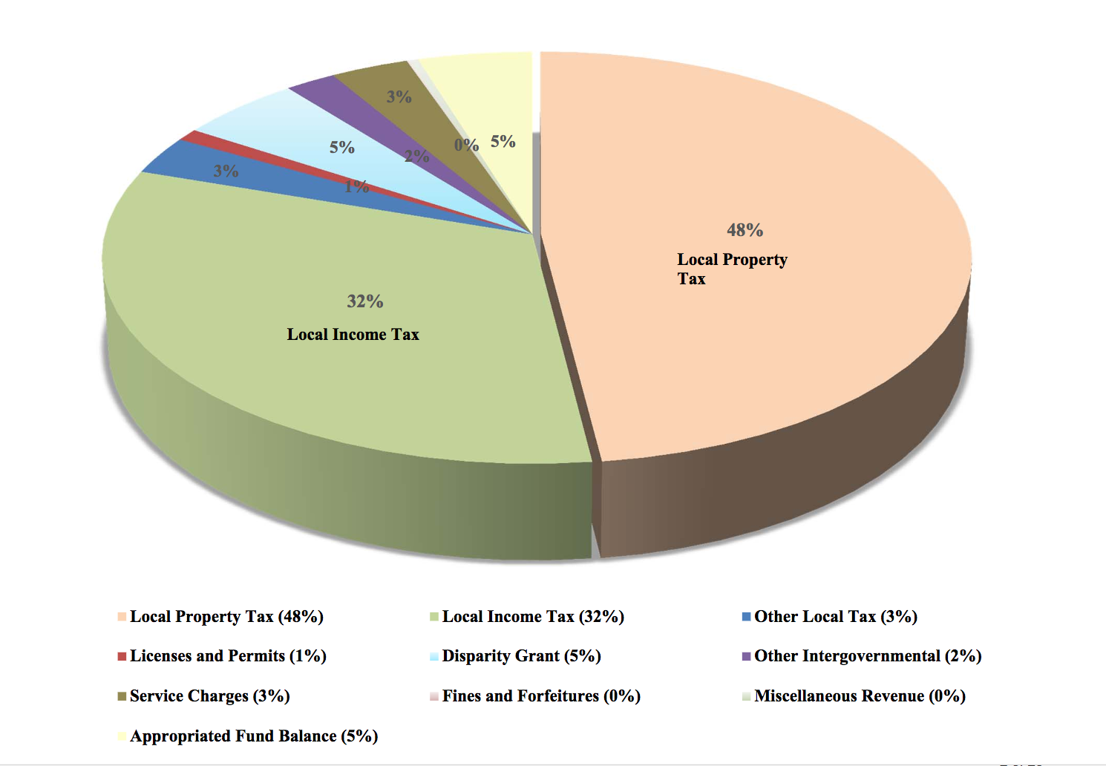
Wicomico County Sources of Revenue
The county relies largely on local property taxes as a source of revenue
Increases in the amount of revenue collected from property taxes however is limited by the revenue cap
Wicomico County Budget, 2016

Slide 5
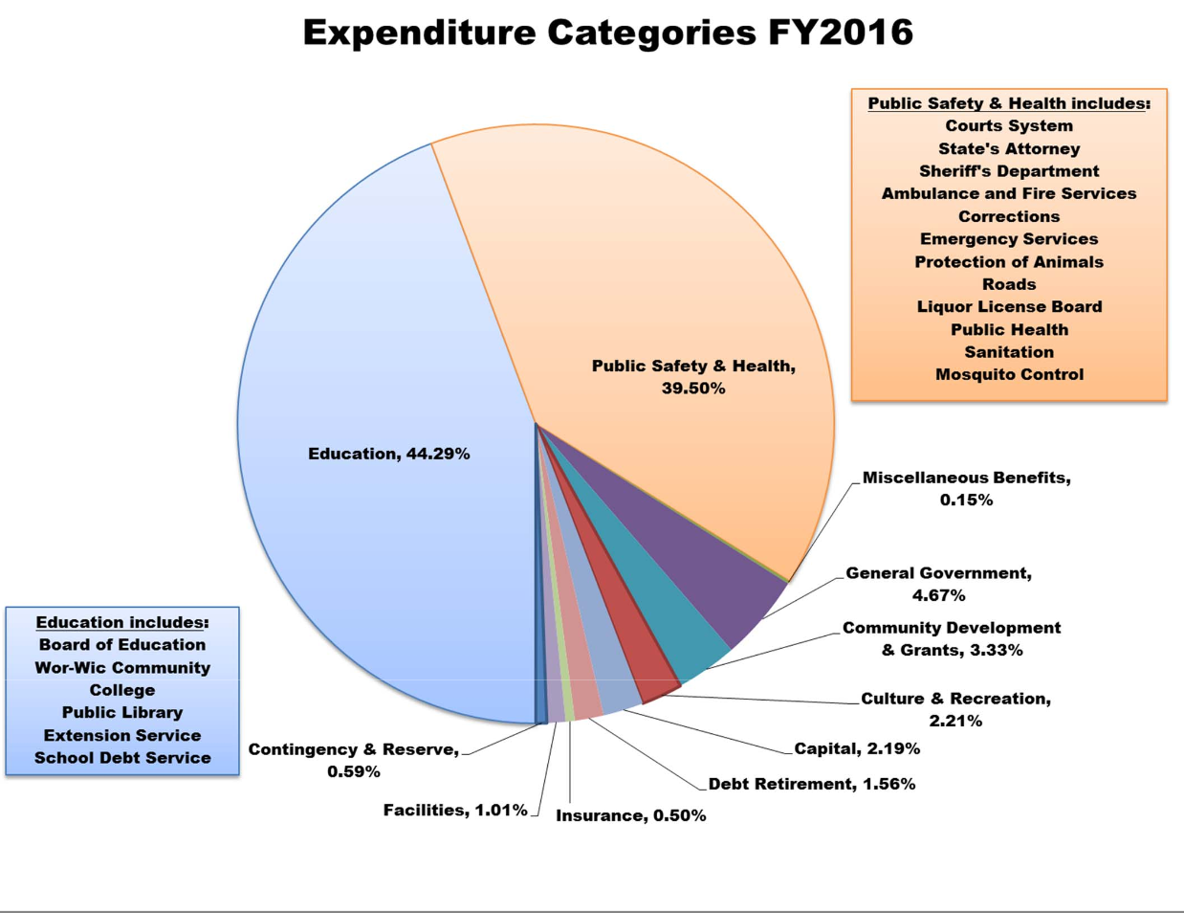
Uses of Revenue- Budget
Since the almost half of the County’s budget comes from property taxes collected, this revenue is used to fund a lot of public services including:
  Education
  Public Health
  Facilities in the county
  Recreation
  Economic and Community Development
  Infrastructure
  Maintenance of roads
  Public Safety

Slide 6
Revenue Cap Challenges
The objective of the revenue cap is to limit wasteful government spending and eliminate unexpected large tax increases. There are however, some unintended consequences of the current format of Wicomico County’s revenue cap.
  The cap only works in an environment where inflation is 2% or less
  The language of the cap creates a ratchet down effect when County revenues fall behind the total allowable revenue.
  The CPI-U rate is not an accurate measure of the rate of change in local government expenditures.
  The revenue cap is not designed to accommodate unfunded state or federal mandates
  The revenue cap does not have an emergency contingency provision to allow elected officials to address extraordinary budgetary demands in cases of disasters or major economic disruptions

Slide 7
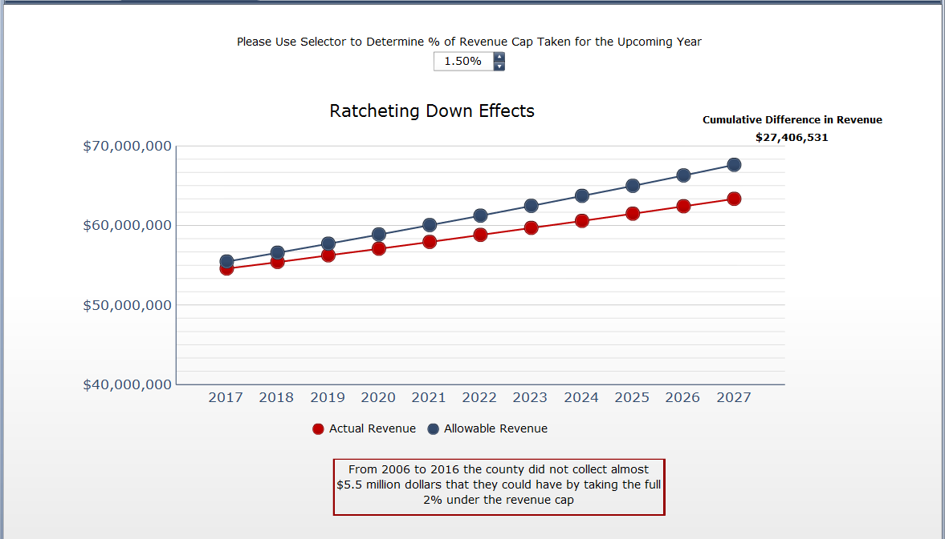
Ratcheting Down Effects
In the past the County has taken less than the full allowable revenue under the cap. (e.g. in 2009 the county only allowed a revenue increase of 0.1% instead of the full 2%)
Not taking the fully allowable revenue has led to over $5 million being forever left on the table. This has a further detrimental effect since all future increases will be limited by this lower base figure.
This ratcheting effect could lead to the County losing out on over $25 million dollars in the next 10 years

Slide 8
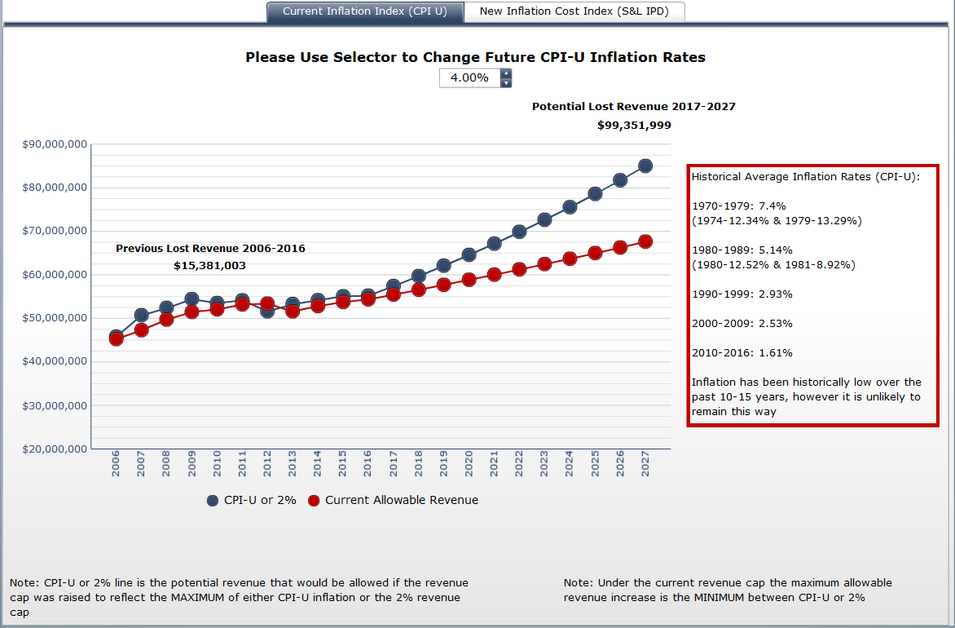
Lost Revenue
The county has also been unable to collect and use over $15 million dollars from 2006-2016
This loss is due to the fact that inflation has been higher than 2% revenue cap during this time period.
Should inflation increase to historical averages, the County will be unable to collect millions of dollars in revenue in that year; and the ratcheting effect will compound the loss in revenue in future years.

Slide 9
What Could Happen
During a period of high inflation or increases in County expenditures due to growth, unfunded mandates or unforeseen emergencies, there is no option to adequately adjust the budget.
Similarly, the County would have no cushion during a major economic downturn which is when reliance on public and social services in the county would increase.

Slide 10
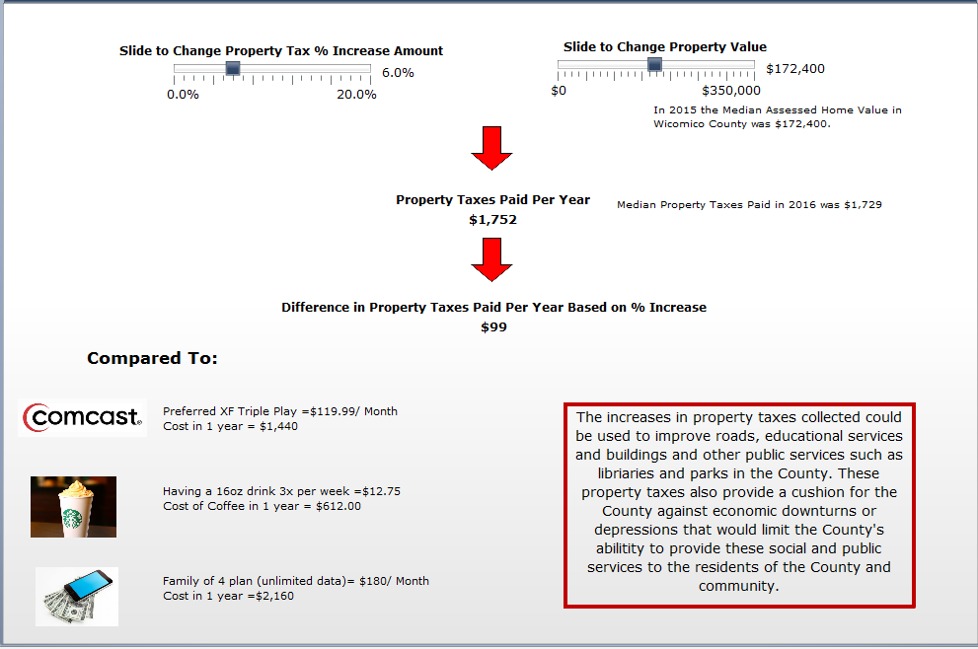
Examining Changes in Property Taxes
Due to the ratcheting effect of previous tax increases below the cap, the current taxes are below prior levels when adjusted for inflation.
If the current tax rate per $100 of assessable value (.9587) is increased by 6%, the owner of a median assessed value home ($172,400) would only pay $99 more that year in property taxes, which is below prior taxes when adjusted for inflation

Slide 11
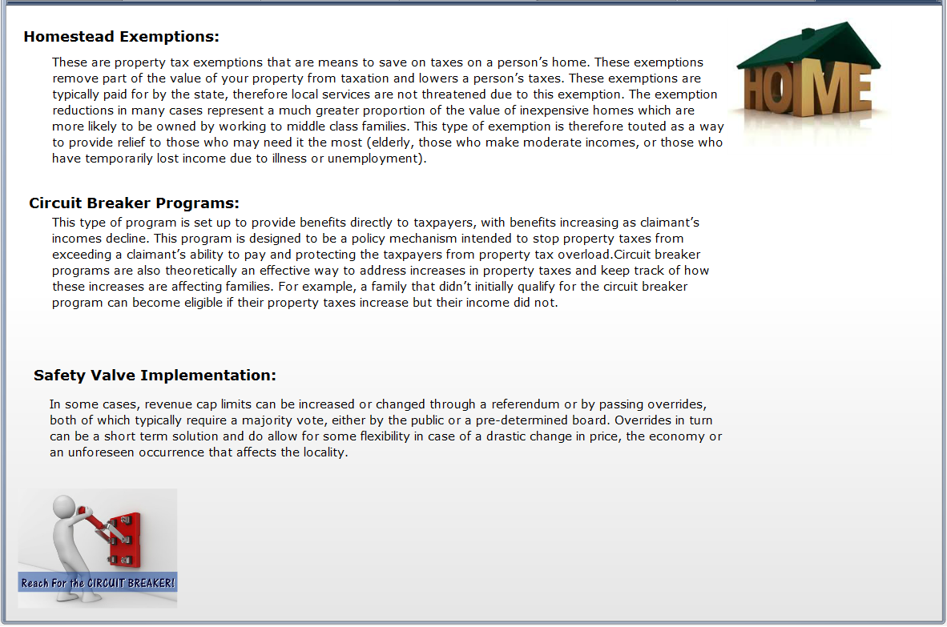
Protecting Residents from Large Rate Increases
Some of the unintended consequences of the current format of the revenue cap could be mitigated through modest changes to the policy, such as those listed in this slide.
Such changes would still allow the County to protect residents from large increases in property taxes

Slide 12
What Could We Be Doing?
Modest changes to the Revenue Cap policy could allow the County to:
  Improve more roads, bridges and walkways in the county
  Improve more schools and educational services
  Reduce the amount of deferred expenditures
  Increase funding to public safety
  Increase funding to health and public services
  Increase funding to recreation, parks and libraries
  Increase funding to projects geared towards improving quality of life and retaining young professionals
  Fund more economic development projects
  Save money for disasters, increases in inflation, growth in population, unfunded State mandates or economic downturns
  CHANGE INCREASE WORDING/ BULLETS AFTER PUBLIC SAFETY

Slide 13
Enhancements Moving Forward
Implementation of a safety valve feature
Using homestead exemptions or circuit breaker programs
Changing the language of the cap to be able to take the higher of CPI-U or 2% each year
Using a different inflation index (S&L IPD) instead of the CPI-U index
Sunset/Reset Clause

